Slide 1
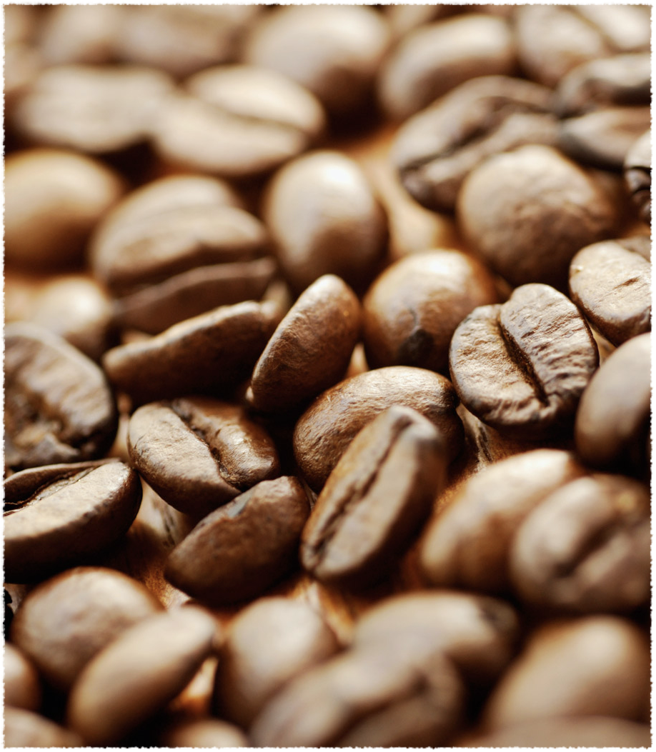
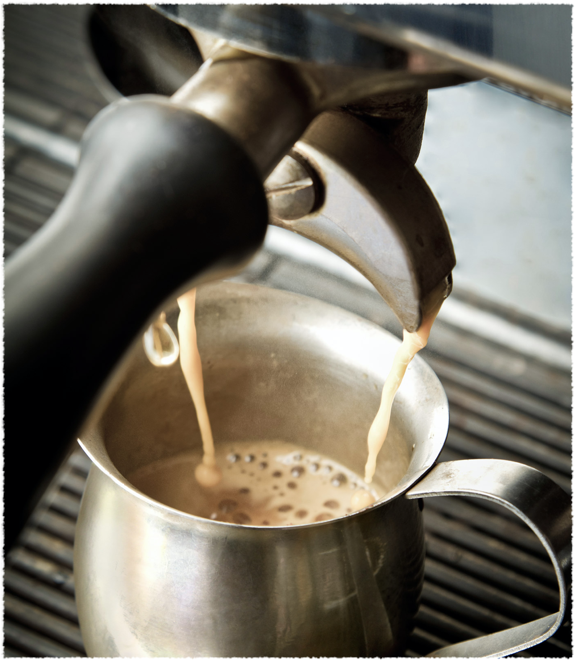
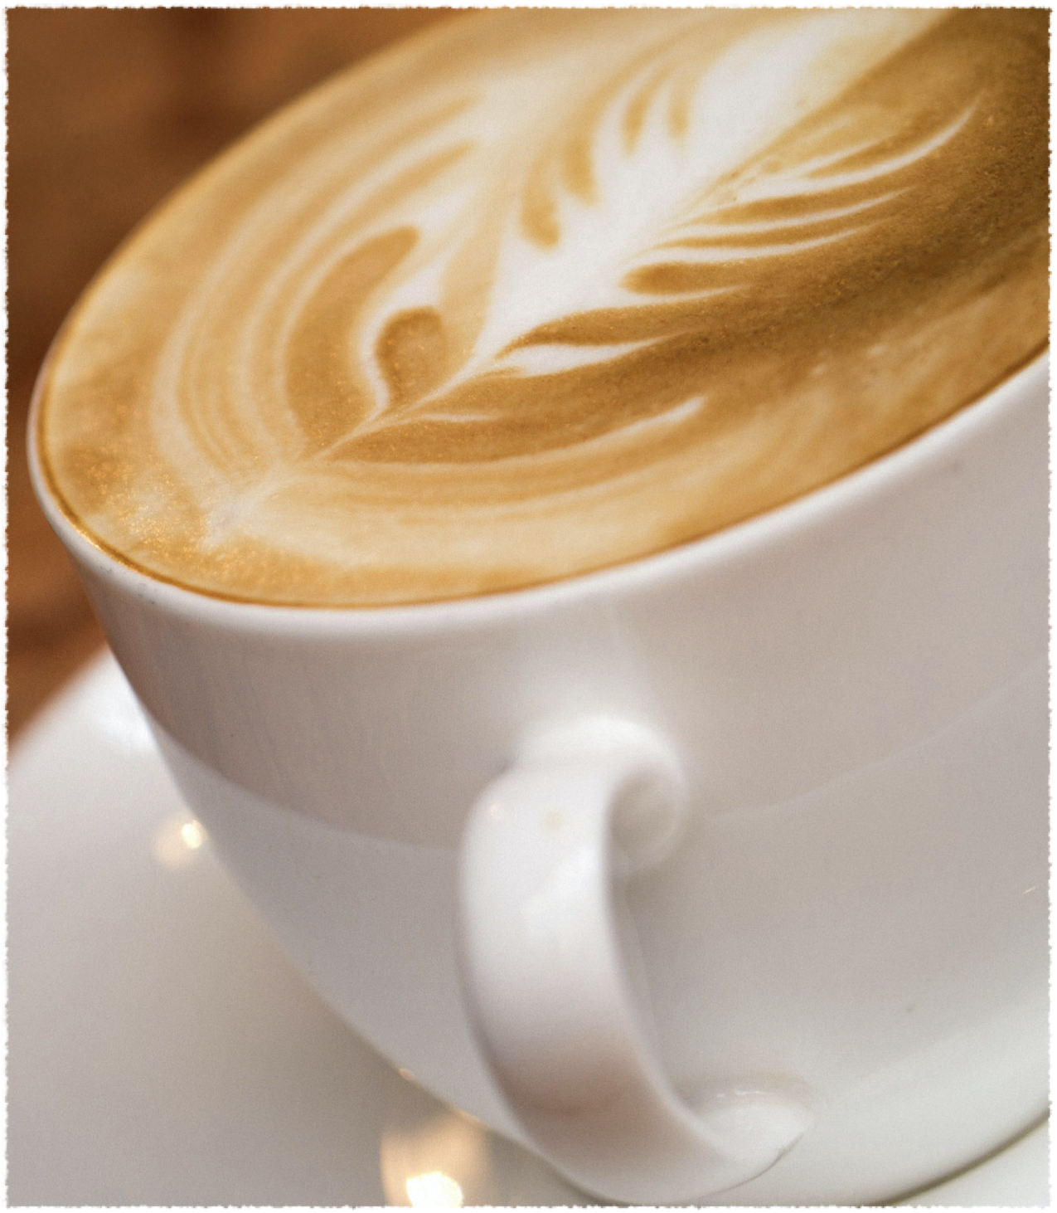
Another Café in Seoul
H.H.Lee

Slide 2
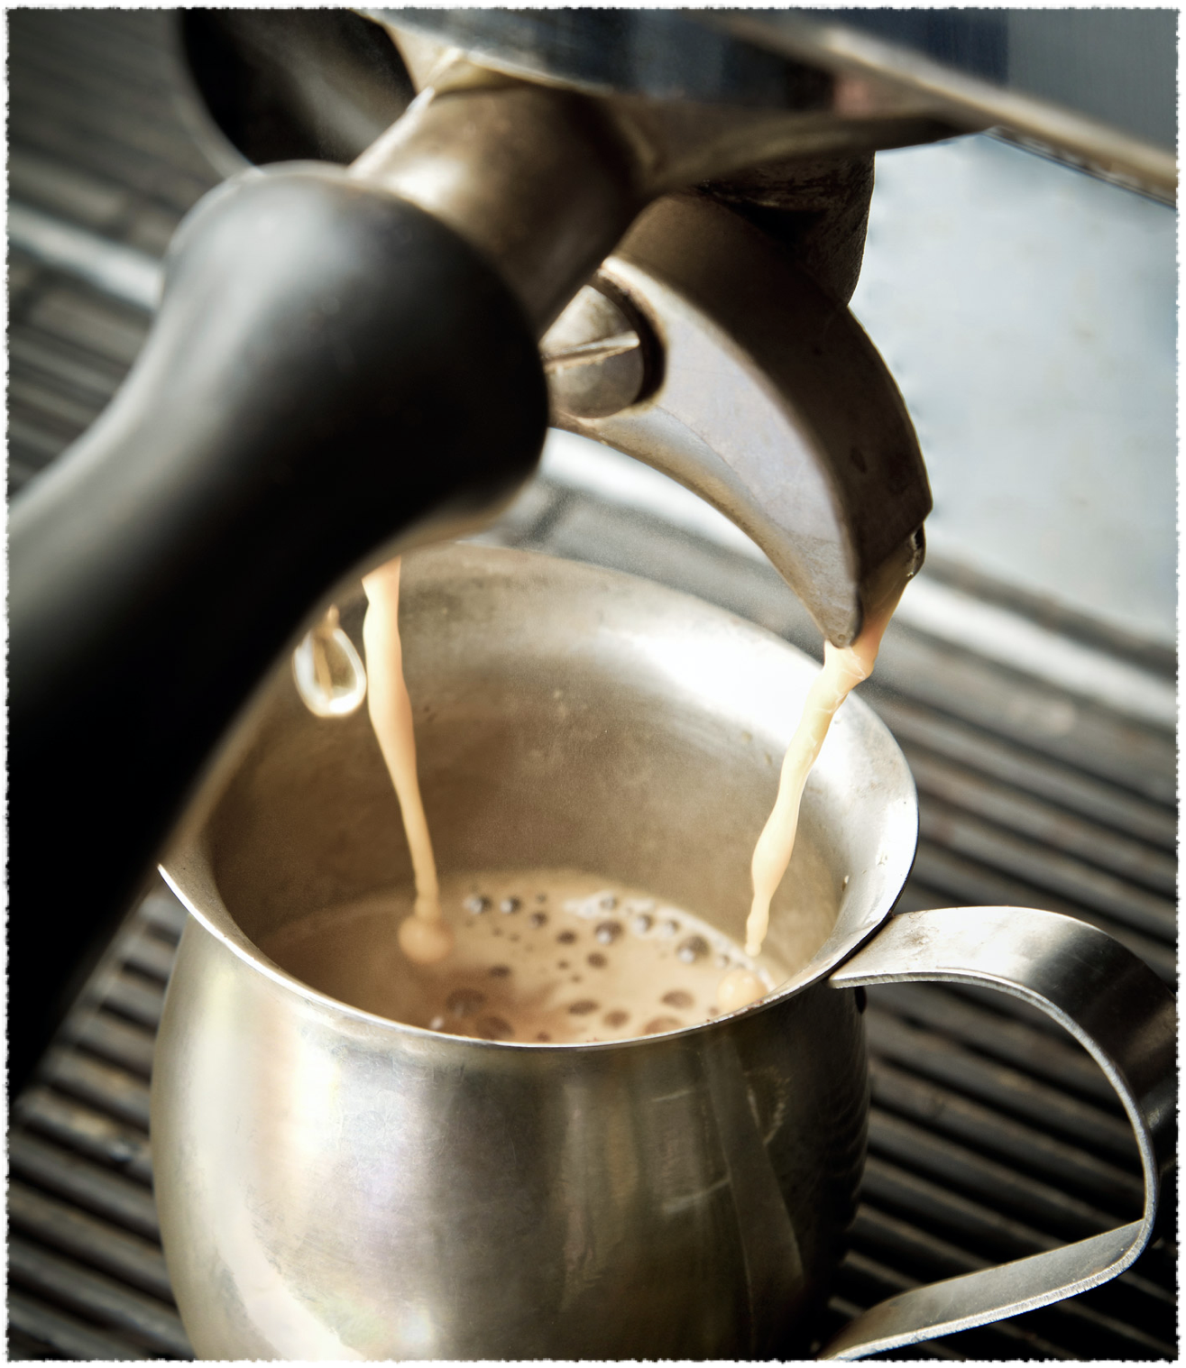

Quest
Café is a popular retirement plan in South Korea.
5.7 billion dollar industry
average adult drinks 353 cups of coffee per year
However, coffee shop market reached the saturation point in 2018 (Hyundai Research Institute).
So where should we set up a cafe in a city saturated with big and small coffee shops?

Slide 3
Consulting the experts
According to commercial property experts:
Traffic-Rent Tradeoff: target the edge of commercial district for foot traffic + cheaper rent.
Don’t set up near malls — Goliath competitor.
Avoid competitor within 200-300m radius.
Office complex and university is a boost.

Slide 4
Research Goal
Based on the expert advice, we will look for a district with
One or more universities in the vicinity.
Less malls.
Less coffee shop saturation

Slide 5
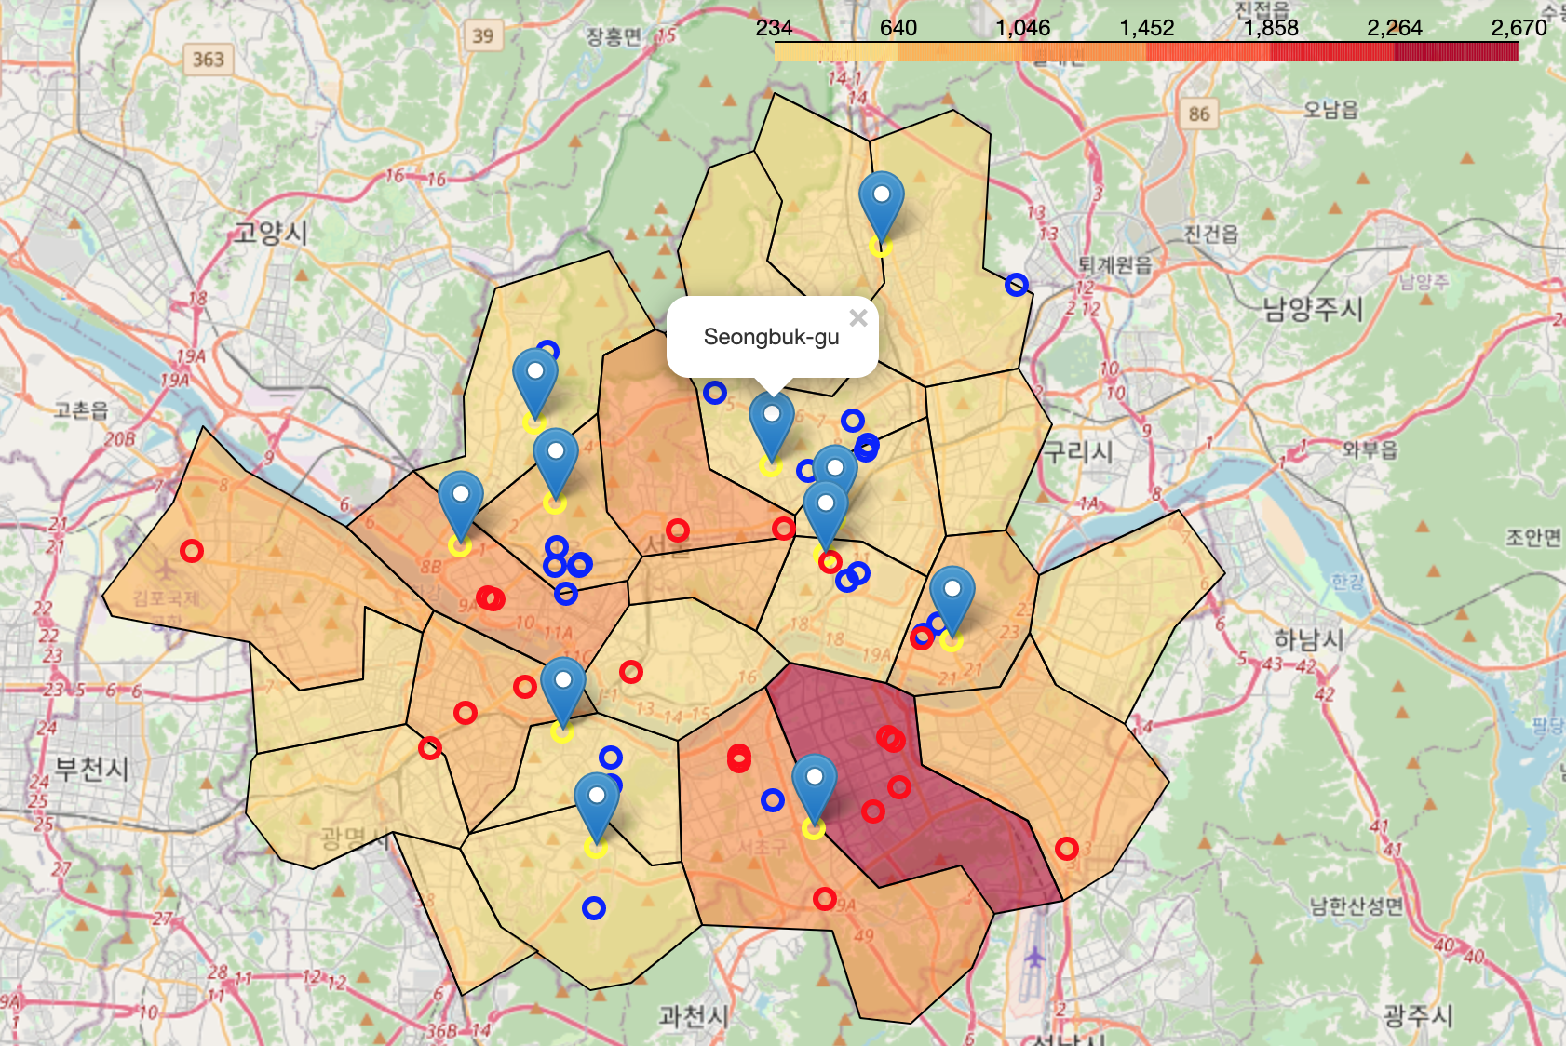
Blue: University
Red: Mall
Yellow to Red : Coffee shop density

Slide 6
Recommendation
Based on the above criteria, we recommend the following three eastern districts, not too far from the center of Seoul:
Seongbuk-gu
Dongdaemun-gu
Seongdong-gu

